Slide 1



Greening Through Procurement
Notes:
This portion of our training is applicable to all MCAS Miramar personnel involved in procurement of products and services - which is a broad audience!

Slide 2
MCAS Miramar:
Consumes a wide variety of hazardous, toxic, and non-renewable materials (e.g., fuel, paint, cleaners, plastics, etc.)
Procures a wide variety of products and services daily through numerous contracts, credit cards, and other mechanisms
Generates large quantities of hazardous waste
Must comply with numerous environmental and safety requirements
Notes:
Remind attendees that MCAS Miramar is basically a city with numerous organizations procuring a wide-variety of products and services daily. Procurement decisions are made by many personnel and each of these decisions impacts the environment.

Slide 3
Sustainable or “Green” Procurement:
Gives preference to products and services that have a lesser or reduced effect on human health and the environment when compared with competing products or services that serve the same purpose.
Lessens danger to human health and the environment
Reduces hazardous waste, environmental emissions, and compliance costs
Is applicable to all contracting/procurement actions/credit card purchases by Marine Corps commands, operations, and systems except military tactical vehicles and equipment
Notes:
Green procurement principles should be applied at home and the workplace.
Green procurement extends well beyond the purchase of safer hazardous materials. It includes energy- and water-efficient appliances, biobased fuels, products made from recycled materials, alternative-fuel vehicles, etc.
Preference for green products and services is required throughout the Marine Corps.

Slide 4
Green Procurement Examples
Carpet with recovered material content
Paper products with recycled fiber content
Biodiesel fuel
Electric vehicles
Locally sourced products and services
Appliances with high Energy Star® ratings
Low-flow water fixtures
Bio-based and non-toxic cleaning products
Notes:
Emphasize that green procurement can be applied to services as well as products. For example, specifying in a Request For Proposal (RFP) that carpet for a building renovation consist of >25% recycled materials.
Use of local suppliers cuts down on GHG emissions.

Slide 5
GSA Green Procurement Compilation (GPC)
https://sftool.gov/greenprocurement
Gateway to identifying green products and services
Catalog of green purchasing options and requirements spanning the 27 product and 9 service categories
Provides direct product links to the GSA Advantage website to facilitate procurement
Provides example contract clauses and provisions addressing green procurement
Notes:
The GPC is a comprehensive resource that helps identify green products and services and applicable green purchasing requirements by consolidating and organizing information from various Federal environmental programs into a single location.
GPC should be the first stop prior to making a procurement decision.
Emphasize direct links to GSA Advantage.

Slide 6
Green Procurement Compilation (GPC) Product and Service Categories
Products (number of subcategories)
Appliances (21) | Biomedical Equipment and Supplies (17) | Building Finishes (18)
Building Furnishings (7) | Cafeteria Products (28) | Cleaning Products (52)
Construction Materials (17) | Contracted Printing Products (8) | Doors and Windows (4)
HVAC/Mechanical (24) | Landscaping Products (17) | Lighting and Ceiling Fans (16)
Lube, Oil, Hydraulic Fluid, and Grease (20) | Miscellaneous (36) | Non-Paper Office Products (11)
Office Electronics (29) | Paper Office Products (10) | Park and Recreation (12)
Personal Care (18) | Plumbing Systems (6) | Refrigeration Systems (2)
Renewable Energy (9) | Roadway Construction (11) | Shipping, Packaging & Packing Supplies (8)
Special Construction Products (6) | Traffic Control (8) | Vehicles and Vehicle Products (20)
Services
Cafeteria & Food Services | Electronic Leasing | Fleet Maintenance
Janitorial Services | Landscaping Services | Laundry Services
Meeting & Conference Services | Pest Management | Transportation Services
Notes:
Note the wide-variety of product and service areas where green procurement alternatives can be readily identified.

Slide 7
Additional Green Procurement Resources
Category | Link(s)
All | https://sftool.gov/greenprocurement
Recycled Content Products | CalRecycle.calrecycle.ca.gov/BuyRecycled/Manufacturers/Directory/ sftool.gov/gpcsearch?query=recycled+content
Environmentally Preferable Products and Services | www.epeat.net/ CalRecycle.calrecycle.ca.gov/BuyRecycled/Manufacturers/Directory/ https://www.epa.gov/greenerproducts/recommendations-specifications-standards-and-ecolabels-federal-purchasing
Biobased Products | https://www.biopreferred.gov/BioPreferred/faces/catalog/Catalog.xhtml
Energy and Water Efficient Products | https://www.energy.gov/eere/femp/search-energy-efficient-products www.energystar.gov/products www.energy.gov/eere/femp/best-management-practices-water-efficiency www.epa.gov/watersense
Alternative Fuel and Electric Vehicles | https://sftool.gov/greenprocurement/green-products/18/vehicles-vehicle-products/1485/alternative-fuel-vehicles/0?addon=False&active=details https://www.gsa.gov/buying-selling/products-services/transportation-logistics-services/fleet-management/vehicle-leasing/alternative-fuel-vehicles https://afdc.energy.gov/ https://gem.polaris.com/en-us/
Products using renewable energy | https://sftool.gov/greenprocurement/green-products/15/renewable-energy/0
Alternatives to hazardous or toxic chemicals | https://www.epa.gov/saferchoice/products
Notes:
These links will lead users to more information and specific green product alternatives.
Note that MCO 5090.2 emphasizes the 7 green procurement categories listed in the table.

Slide 8
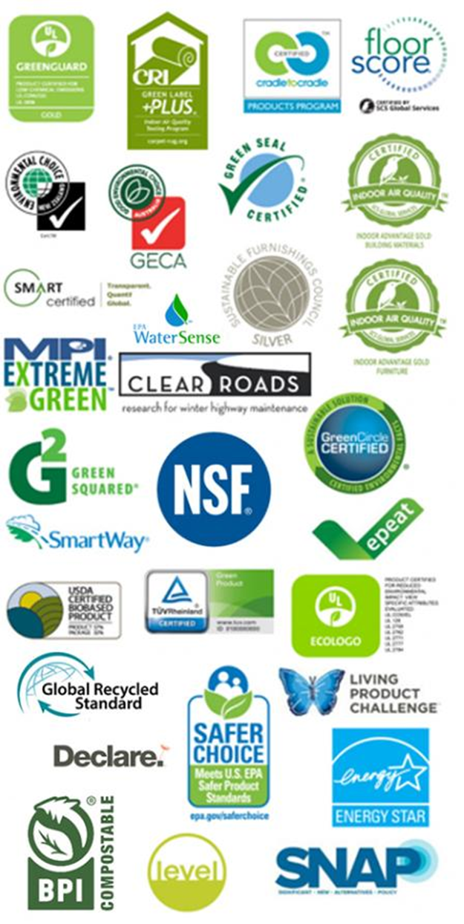
EPA-Recommended Green Product Labels
Notes:
Products with these labels identify those meeting EPA standards.

Slide 9
Green Procurement Tips
Look for product labels that indicate the highest percentage of post-consumer recovered material content.
When placing service orders or working with outside contractors, include recycled or recovered material content as a requirement for all materials used.
Use the USEPA EPEAT tool when purchasing electronic products.
When placing service orders or developing RFPs, establish a percentage requirement for any wood that is used to be derived from a sustainably managed forest.
Notes:
Emphasize again that green procurement requirements should be included within RFPs and contract language.

Slide 10
Green Procurement Tips
Look for the Energy Star® label when procuring new lightbulbs, appliances, electronics, etc.
Look for WaterSense® or WaterWise® labels when purchasing new toilets, showerheads, faucets, and establish requirements to meet these standards for any future building construction, renovation, or repair.
Utilize the Green Procurement Compilation (GPC) alternative fuel vehicle page to access vehicle purchase and leasing options through GSA.
Utilize the DOE Alternative Fuels Data Center to identify fueling options.

Slide 11
Green Procurement Tips
Consider non-traditional electric vehicles as substitutes for trucks in various functions around the installation, such as public works maintenance activities.
Make all hazardous material purchases through the MCAS Miramar HazMin Center located at located at Building 8672.
Identify safer products through the GPC and USEPA Safer Choice websites.

